Slide 1
The Impact of COVID on Mental Health among Children and Youth
Presented by Nakeya T. Fields, LCSW, PPSE,
Registered Play Therapist - Supervisor,
Trauma Informed Yoga Therapist
Founder, Therapeutic Play Foundation
Chair, Black Mental Health Task Force
Faculty, CSU Northridge Tseng College
@TheFeelWellCoach on social media platforms
Your Presentation Facilitator
This presentation will be recorded for quality assurance and training purposes. Presentation produced 2022 by ©NakeyaFieldsLicensedClinicalSocialWorkerPC and is not to be reproduced or distributed without prior consent. All rights reserved.

Slide 2
Before We Begin...
Pen/Pencil and Paper Nourishment Cultivate a Comfortable Space
©NakeyaFieldsLicensedClinicalSocialWorkerPC
Notes:
Images cited
Pen paper: https://unsplash.com/@jodrell
Coffee cup: https://unsplash.com/@anniespratt
Woman workspace: https://unsplash.com/@wocintechchat

Slide 3
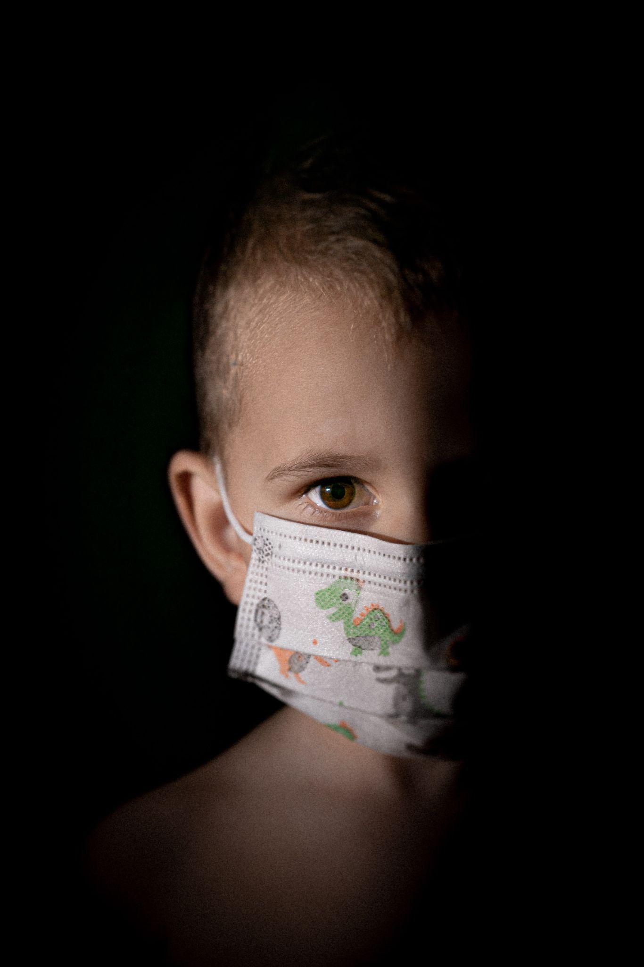
Learning Objectives
Gain Basic Awareness of Symptoms of trauma
Explore connection between physical & mental health as related to Covid-19
Be able to identify ACES & impact on youth
Leave with 3 coping strategies for social emotional progress
hhhhlll
©NakeyaFieldsLicensedClinicalSocialWorkerPC
Notes:
-understand symptoms of trauma and the impact of chronic stress on a child’s development
-The link between physical and mental wellness. How mindset and thoughts impact physical ability and immune system
-Understand the impact of ACEs on a child’s ability to access their educational curriculum and engage in appropriate developmental activities and social interactions.
-Participants will learn at least 3 coping strategies that foster successful social emotional progress for the family unit as it relates to the family’s collective experience in education.
Image source: https://unsplash.com/photos/JCcz54otNhU?utm_source=unsplash&utm_medium=referral&utm_content=creditShareLink

Slide 4
What is Trauma?
©NakeyaFieldsLicensedClinicalSocialWorkerPC
Notes:
Trauma, as defined by the American Psychological Association (APA), is an emotional response to a terrible event such as an accident, rape, or natural disaster. These events can be considered deeply distressing or disturbing, resulting in physical or psychological trauma. It’s important to know that there are three main types of trauma: acute, chronic, and complex.
When subjected to trauma, a person may respond in several ways. They may be in a state of shock, grief, or denial. The APA revealed that people may even experience long-term reactions. For example, individuals may experience unpredictable emotions, flashbacks, strained relationships, and even physical symptoms.
there is also a form of secondary trauma, called vicarious trauma. This occurs when a person develops trauma symptoms from close contact with someone who has experienced a traumatic event. The symptoms will often mirror those associated with PTSD.
Source: https://www.feinbergcare.com/three-types-trauma
-Children who suffer from child traumatic stress are those who have been exposed to one or more traumas over the course of their lives and develop reactions that persist and affect their daily lives after the events have ended. Traumatic reactions can include a variety of responses, such as intense and ongoing emotional upset, depressive symptoms or anxiety, behavioral changes, difficulties with self-regulation, problems relating to others or forming attachments, regression or loss of previously acquired skills, attention and academic difficulties, nightmares, difficulty sleeping and eating, and physical symptoms, such as aches and pains. Older children may use drugs or alcohol, behave in risky ways, or engage in unhealthy sexual activity.
Children who suffer from traumatic stress often have these types of symptoms when reminded in some way of the traumatic event. Although many of us may experience reactions to stress from time to time, when a child is experiencing traumatic stress, these reactions interfere with the child’s daily life and ability to function and interact with others. At no age are children immune to the effects of traumatic experiences. Even infants and toddlers can experience traumatic stress. The way that traumatic stress manifests will vary from child to child and will depend on the child’s age and developmental level.
Without treatment, repeated childhood exposure to traumatic events can affect the brain and nervous system and increase health-risk behaviors (e.g., smoking, eating disorders, substance use, and high-risk activities). Research shows that child trauma survivors can be more likely to have long-term health problems (e.g., diabetes and heart disease) or to die at an earlier age. Traumatic stress can also lead to increased use of health and mental health services and increased involvement with the child welfare and juvenile justice systems. Adult survivors of traumatic events may also have difficulty in establishing fulfilling relationships and maintaining employment.
Traumatic experiences leave a legacy of reminders that may persist for years. These reminders are linked to aspects of the traumatic experience, its circumstances, and its aftermath. Children may be reminded by persons, places, things, situations, anniversaries, or by feelings such as renewed fear or sadness. Physical reactions can also serve as reminders, for example, increased heart rate or bodily sensations. Identifying children’s responses to trauma and loss reminders is an important tool for understanding how and why children’s distress, behavior, and functioning often fluctuate over time.
Source:
Source:

Slide 5
Types of Trauma
Acute - single distressing event
Chronic - repeated & prolonged exposure to distressing event
Complex - multiple traumatic events, often invasive/ interpersonal in nature
Vicarious/Secondary - exposed to distressing images & stories 2nd hand.
©NakeyaFieldsLicensedClinicalSocialWorkerPC
Notes:
When you experience a traumatic event, it activates the limbic system in the brain. This “fire alarm” shuts down all nonessential systems (rest, digestion, sleep) and floods your body with stress hormones, like cortisol, so you can prepare for fight, flight, or freeze.
Once the danger passes, your parasympathetic nervous system provides inner calm, otherwise known as your “rest and digest” mode.
At this point, normal cognitive function returns, and you can go back to your day with relatively few side effects, perhaps only feeling a little jittery for a while, or a bit on edge. If we are lucky…
Acute Trauma Symptoms:
Symptoms of acute trauma will generally include:
Excessive anxiety or panic
Shock or denial
Feelings of guilt, sadness, grief, or hopelessness
Irritation
Confusion
Nightmares or insomnia
Feeling disconnected
Lack of trust
Inability to focus on work or studies
Lack of self-care or personal hygiene
Aggressive behavior
Chronic Trauma Symptoms:
may result from a long-term serious illness, sexual abuse, domestic violence, bullying, and subjection to other extreme situations. Several events of acute trauma, as well as untreated acute trauma, may develop into chronic trauma. The symptoms of chronic trauma can even appear years after the event took place.
Symptoms
-unpredictable emotional outbursts,
-anxiety
-extreme anger
-flashbacks
-fatigue
-body aches
-headaches,
-nausea.
-Trust issues may also be present, resulting in unstable relationships, and instability with work.
Complex Trauma:
For people who live with complex trauma, balance doesn’t quite return the way it needs to after a distressing event. The parasympathetic nervous system does not engage and put us into a rest state.
Instead, the limbic system stays engaged most of the time. It’s a coping mechanism to try and stay safe in the face of ongoing adversity. It’s an experience of constantly being in survival mode, or on edge.
Over time, it becomes a “new normal” for the brain and body.
Rsearchers estimate that more than 3% of people meet the criteria for complex trauma, also called complex post-traumatic stress disorder (C-PTSD), in the United States.
This bodily state of your nervous system being on “high alert” can affect your thoughts, actions, and relationships.
Some symptoms of complex trauma include:
flashbacks
lapses in memory
difficulty regulating emotions
hyperarousal, or being “on alert”
dissociation or lapses in memory
depersonalization or derealization
sleep disturbances or nightmares
struggling in interpersonal relationships
low self-esteem or negative self-perception
avoiding people, places, or scenarios that upset you
Somatic (bodily) symptoms, like unexplained headaches or an upset stomach, are also common with complex trauma. Since the body is under chronic stress, it can lower your immune system and lead to a range of chronic health conditions.
Vicarious Trauma - Vicarious trauma (VT) and Secondary Traumatic Stress (STS) are frequently used interchangeably to refer to the indirect trauma that can occur when we are exposed to difficult or disturbing images and stories second-hand.
The term Vicarious traumatization (VT) was coined by Pearlman & Saakvitne (1995) to describe the profound shift in world view that occurs in helping professionals when they work with individuals who have experienced trauma: helpers notice that their fundamental beliefs about the world are altered and possibly damaged by being repeatedly exposed to traumatic material. A domestic violence shelter worker may stop being able to believe that any relationship can be healthy. A child abuse investigator may lose trust in anyone who approaches their child. Again, examples of this abound and vary based on the type of work that we do.
Secondary Traumatic Stress (STS) is a concept that was developed by trauma specialists Beth Stamm, Charles Figley and others in the early 1990s as they sought to understand why service providers seemed to be exhibiting symptoms similar to Post Traumatic Stress Disorder (PTSD) without having necessarily been exposed to direct trauma themselves.
VT/STS can occur in professionals who work in high-stress and trauma-exposed fields (child abuse investigators, prosecutors, judges, therapists, health care professionals, animal shelter workers and many others) but it can also affect civilians who do not work in high-trauma fields but are deeply impacted by stories that they are exposed to (maybe graphic news accounts, a friend sharing details of a traumatic event they experienced, again, there are many examples of ways in which this may occur.)
Source: https://www.tendacademy.ca/resources-2/defining-vicarious-trauma-and-secondary-traumatic-stress/
Source: https://psychcentral.com/ptsd/complex-trauma-a-step-by-step-description-of-how-it-develops
Source: https://www.feinbergcare.com/three-types-trauma
Image Source: https://unsplash.com/photos/NPmR0RblyhQ?utm_source=unsplash&utm_medium=referral&utm_content=creditShareLink

Slide 6
What are Adverse Childhood Experiences (A.C.E.S.)?
©NakeyaFieldsLicensedClinicalSocialWorkerPC
Notes:
Adverse childhood experiences, or ACEs, are potentially traumatic events that occur in childhood (0-17 years). Wherein aspects of the child’s environment can undermine their sense of safety, stability, and bonding.
Source: https://www.cdc.gov/violenceprevention/aces/fastfact.html?CDC_AA_refVal=https%3A%2F%2Fwww.cdc.gov%2Fviolenceprevention%2Facestudy%2Ffastfact.html

Slide 7
What are Adverse Childhood Experiences (A.C.E.S.)?
Negative/traumatic events that occur in a child’s life before 18 yrs of age
Can cause toxic stress
Can change brain development
Can increase susceptibility to disease
Can limit career/educational opportunities
©NakeyaFieldsLicensedClinicalSocialWorkerPC
Notes:
According to the CDC, ACEs can have lasting, negative effects on health, well-being, as well as life opportunities such as education and job potential. These experiences can increase the risks of injury, sexually transmitted infections, maternal and child health problems (including teen pregnancy, pregnancy complications, and fetal death), involvement in sex trafficking, and a wide range of chronic diseases and leading causes of death such as cancer, diabetes, heart disease, and suicide.
ACEs and associated social determinants of health, such as living in under-resourced or racially segregated neighborhoods, frequently moving, and experiencing food insecurity, can cause toxic stress (extended or prolonged stress). Toxic stress from ACEs can change brain development and affect such things as attention, decision-making, learning, and response to stress.
Children growing up with toxic stress may have difficulty forming healthy and stable relationships. They may also have unstable work histories as adults and struggle with finances, jobs, and depression throughout life. These effects can also be passed on to their own children. Some children may face further exposure to toxic stress from historical and ongoing traumas due to systemic racism or the impacts of poverty resulting from limited educational and economic opportunities.
Source: https://www.cdc.gov/violenceprevention/aces/fastfact.html?CDC_AA_refVal=https%3A%2F%2Fwww.cdc.gov%2Fviolenceprevention%2Facestudy%2Ffastfact.html

Slide 8
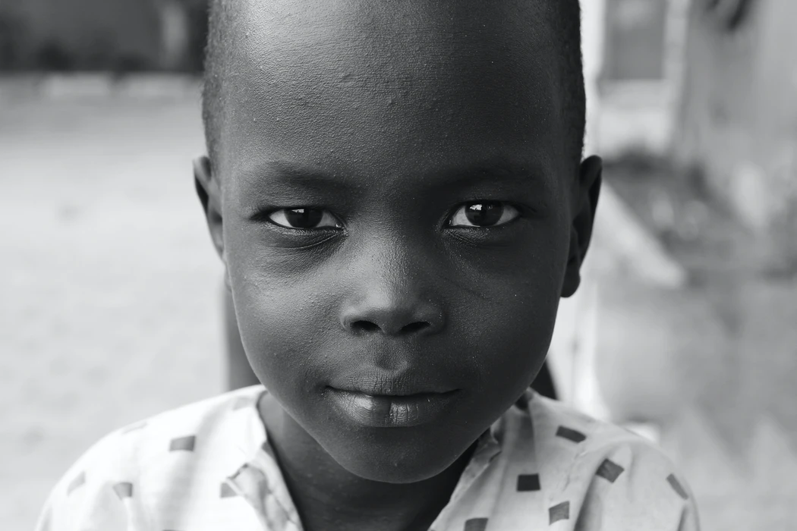
ACES Take Many Forms
Exposure to violence, abuse, or neglect
Experiencing racism and microaggressions
Witnessing violence in the home or community
Having a family member attempt or die by suicide
Being forced to isolate and live in fear of potentially contracting a fatal disease.
©NakeyaFieldsLicensedClinicalSocialWorkerPC
Notes:
Image source: https://unsplash.com/photos/bNrB2XtihHs

Slide 9
The History of ACES and Racial Disparity
Institutionalized racism leads to disparities for children of color
2018: 1 in 5 Black children lived in poverty
ACES associated with:
Lower level formal education
Poor health
Women and minority groups more likely to experience 4+ ACES
©NakeyaFieldsLicensedClinicalSocialWorkerPC
Notes:
-Due poverty and discrimination, racial and ethnic minority youth and families are more likely to be subjected to traumatic events. Cultural context and background, as well as membership in a minority group, will affect how individuals perceive a traumatic event and its impact and how the community can assist in recovery. Mental health professionals must be sensitive to this array of issues and provide help in a culturally responsive manner.
Source: https://www.apa.org/pi/families/resources/children-trauma-update
-Historical and institutionalized racism, which manifests in systemic and structural barriers to equitable access to opportunity, lead to pronounced disparities in socio economic experiences for a large share of America’s children. More than 1 in 5 Black and African American people in the U.S. lived in poverty as of 2018. Historical adversity, which includes slavery, sharecropping, and race-based exclusion from health, educational, social, and economic resources, translates into socioeconomic disparities experienced by Black and African American people today. Adverse childhood experiences (ACEs) are associated with lower educational attainment, vocational achievement, and worse health outcomes. Historically women and several racial/ethnic minority groups were at greater risk for having experienced 4 or more types of ACEs. It is especially important to recognize that having a high ACE score does not necessarily mean that an individual is fated to suffer poor health or engage in risky behaviors. When children’s positive experiences outweigh the negative, the child is more likely to have positive outcomes later in life.
Image source: https://unsplash.com/photos/LPaeGH0xHgw

Slide 10
ACEs and the Impact on African American Education
Chronic absenteeism
Delayed development
Misdiagnosis of disorders
ACEs can negatively affect focus, academic engagement and relationships
ACEs can negatively impact physical development into adulthood
©NakeyaFieldsLicensedClinicalSocialWorkerPC
Notes:
Can cause chronic Absenteeism (missing close to 15 days of the school year)
Delayed reading, writing, and mathematic ability
Increase chances of Retention
Hindrance of appropriate social development
Mis-diagnosis of learning and behavioral disorders
Students are more likely to have poor executive functioning and decision making
ACEs can increase disengagement and uninterest in Academics
ACEs can impact student’s developing positive support relationships with school staff
Carlson, P. (2019). Impact of Adverse Childhood Experiences on Academic Achievement of School-Aged Learners (Thesis, Concordia University, St. Paul). Retrieved from https://digitalcommons.csp.edu/ teacher-education_masters/4
An ACE score is a tally of different types of abuse, neglect, and other hallmarks of a childhood that includes difficult and/or traumatic experiences. According to the Adverse Childhood Experiences study, the more trauma type incidents that occur in childhood, the higher the score is likely to be and the higher the risk for later health problems. Studies have shown that there is much disparity in the health outcomes of Black persons.
WHAT DOES MY SCORE MEAN? The ACES tool includes 10 questions and you can score from 0 up to 10. This assessment cannot predict our future, but it can serve as a screener to identify people who may benefit from services to help build resilience, focus and self-control that will decrease the maladaptive impact of long term exposure to toxic stress, and traumatic incidents.

Slide 11
ACEs and Individual Health
Childhood adversity, depressive symptoms and antisocial behavior
Depression in school-aged children
Exposure to toxic stress
Chronic health conditions:
Diabetes
Heart disease
Pulmonary disease
Liver disease
Cancer
©NakeyaFieldsLicensedClinicalSocialWorkerPC
Notes:
There are strong associations between childhood adversity, depressive systems, and antisocial behavior.
People who are stressed do not make rational well thought out decisions and not operating as their best selves. Including children. When stressed, it will be difficult to learn and access their educational curriculum. They are operating in their reptilian brain and cannot think as clearly as they would if their nervous systems were not inflamed and thinking they are in danger.
Depression is one of the most prevalent mental health disorders among school-aged learners with ACEs
School-aged learners identified as having one or more ACE are prone to negative effects of toxic stress.
Toxic stress weakens the architecture of the developing brain
ACEs are associated with worse with chronic health conditions such as diabetes, heart disease, chronic obstructive pulmonary disease, liver disease, and cancer.
https://developingchild.harvard.edu/science/key-concepts/toxic-stress/
Brinker, J., & Cheruvu, V. K. (2017). Social and emotional support as a protective factor against current depression among individuals with adverse childhood experiences. Preventive Medicine Reports, 5, 127-133. doi:10.1016/j.pmedr.2016.11.018
Image source: https://unsplash.com/photos/aeh1dbI_a7I

Slide 12
The Covid-19 Pandemic is a Trauma/ACES Event for Children and their Families
©NakeyaFieldsLicensedClinicalSocialWorkerPC
Notes:
The danger and scope of the COVID-19 pandemic has upended “normal” life for more almost two years now, causing billions of people around the world to experience unexpected long term emotional turmoil. Children have been born into a world without seeing smiles and missing out on learning social cues associated with touch.
You don’t have to experience violence to experience trauma. Any time a person feels unsafe, out of control, or at risk of serious injury, illness, or death, the experience may be traumatic for them.
Some people during this pandemic feel more on guard or unsafe, have an increase in negative thoughts and feelings, and have problems with sleep and concentration — also symptoms of PTSD trauma.
The pandemic has left many of us, including children, feeling completely out of control. And the loss of routine, the disruption to school and family gatherings, the inability to interact with our loved ones as we once did — all of this isn’t only disorienting to children, it can even be dangerous.
Children who are watching the news a lot seem to show more symptoms, possibly due to the repeated exposure to possibly traumatic material on TV or online. Even if someone has not been personally affected by the pandemic, it’s possible to develop vicarious trauma simply from repeatedly watching others suffer.
Source: https://www.healthline.com/health-news/the-world-is-experiencing-mass-trauma-from-covid-19-what-you-can-do#Understanding-the-definition-of-trauma

Slide 13
The Relationship Between
Mental & Physical Health In The Pandemic
It is easy to feel overwhelmed and to feel anxious and scared when there are restrictions and changes to normal routine. When feeling overwhelmed, the body can manifest somatic symptoms.
Increased stress and anxiety can diminish mental energy, concentration and the body's natural ability to fight infection and build immunity
Managing stress is one of the things we can do to make ourselves and our families stronger. Children watch and copy everything we do, including how we regulate emotional distress.Physical distress can look like irritability and frustration.
Our mindset determines our ability to have a healthy routine. That requires self-love and an ability to set boundaries with self to take better care of physical body.
©NakeyaFieldsLicensedClinicalSocialWorkerPC
Notes:
Stress is A response of the organism/body to a state of stress that is usually beyond our control. It manifests itself physically, and emotionally, and in behavior.
Because Covid 19 is a stressful event that comes with its own physical symptoms outside of the body’s stress response, it can be very devastating to a person with less practice managing their symptoms.
Image source: https://unsplash.com/photos/wtxcaDIdOCM?utm_source=unsplash&utm_medium=referral&utm_content=creditShareLink

Slide 14
Mental Side-effects
Repetitive negative thoughts
Difficulty concentrating
Difficulty making decisions
Recurring thoughts about death
Irritability/Anger
Isolating
Extreme Fear
Excessive Worry
Hopelessness/Grief
Avoidance of Socialization
Panic attacks
Dizziness
Brain Fog/Overwhelm
Side-Effects of COVID-19
Physical Side-effects
Changes in sleep
Changes in appetite
Pains in different parts of the body
Loss of sexual interest
Lack of energy
Chronic Fatigue
Headaches
Nausea
Fast Heartbeat
TMJ/Lock Jaw
40 year old shoulder
Eczema/Psoriasis
©NakeyaFieldsLicensedClinicalSocialWorkerPC

Slide 15
Solutions for Healing Children & Families
Self-Awareness
Connection To Others
Self-Care Routine
©NakeyaFieldsLicensedClinicalSocialWorkerPC
Notes:
Self-Awareness/Mindfulness - once we understand how the past can infringe upon the present, and how a tough childhood can translate into a tough adult experience, we can become aware of the choices involved in bringing past thoughts into present happenings. We can practice choosing to be free of experiences not currently happening by practicing present focus. There is some relief in being aware of why we act the way we do and then choosing to do different in the moment..
Connection to others - relationships, group esteem, feeling supported, social support is a buffer to stress symptoms. Safe Spaces are necessary for recovery from complex trauma. When we feel safe, we can access all of our abilities. When children are safe in schools, they can free up their brain to learn and feel confident to make friends. When we feel in community, we feel nurtured and able.
Self-Care Routine
- Stress has a physiological impact on the body, including the brain. We can utilize routine to build resilience and heal the brain. The brain is the most plastic organ we have. Meaning it can recover from injury if we practice showing it how. Breathwork, physical movement, yoga, hugs (oxytocin), practicing THE PAUSE increases resilience.Knowledge is power. Once you understand that your body and brain have been harmed by the biological impact of early emotional trauma, you can at last take the necessary, science-based steps to remove the fingerprints that early adversity left on your neurobiology. You can begin a journey to healing, to reduce your proclivity to inflammation, depression, addiction, physical pain, and disease.
Studies report that in people with PTSD, two areas of the brain that are sensitive to stress shrink: the hippocampus, a deep region in the limbic system important for memory, and the anterior cingulate cortex (ACC), a part of the prefrontal cortex that is involved in reasoning and decision-making. Functional magnetic resonance imaging (fMRI), which tracks blood flow in the brain, has revealed that when people who have PTSD are reminded of the trauma, they tend to have an underactive prefrontal cortex and an overactive amygdala, another limbic brain region, which processes fear and emotion (see ‘The signature of stress’).
Source:
https://www.nature.com/news/polopoly_fs/1.11570!/menu/main/topColumns/topLeftColumn/pdf/490165a.pdf?origin=ppub
Image Source:https://unsplash.com/photos/4le7k9XVYjE?utm_source=unsplash&utm_medium=referral&utm_content=creditShareLink
Image Source: https://unsplash.com/photos/y1wVavuxZtE
Image Source: https://unsplash.com/photos/DFtjXYd5Pto

Slide 16
Experiential Activity:
Sound Healing &
Guided Meditation with Breathwork
©NakeyaFieldsLicensedClinicalSocialWorkerPC
Notes:
We have discussed some content that can be dysregulating. Lets normalize releasing toxic stress from our energetic space when we notice its presence. This is an intentional act of self care and self love.
Please get comfortable,
Grab a blanket and a pillow. I invite you to lay down on the floor or get yourself to a nice seating position, where you can let go of tension in your body. This is an opportunity to practice releasing stress from the body, something you can model with your clients if you work with children and families experiencing trauma symptoms.
Image Source: https://unsplash.com/photos/Hn4wYHOaeIc?utm_source=unsplash&utm_medium=referral&utm_content=creditShareLink

Slide 17
Thank
You!
To contact your presentation facilitator, please email her at hello@nakeyatfields.com or visit her website at www.nakeyatfields.com. You can also follow her at @TheFeelWellCoach on social media platforms.

